Slide 1
CS6501/ECE6501 IoT Sensors and Systems
Introduction – August 23, 2017
Brad Campbell – bradjc@virginia.edu
http://www.cs.virginia.edu/~bjc8c/class/cs6501-f17/

Slide 2
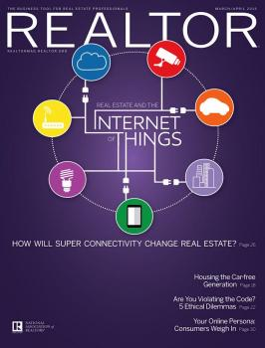

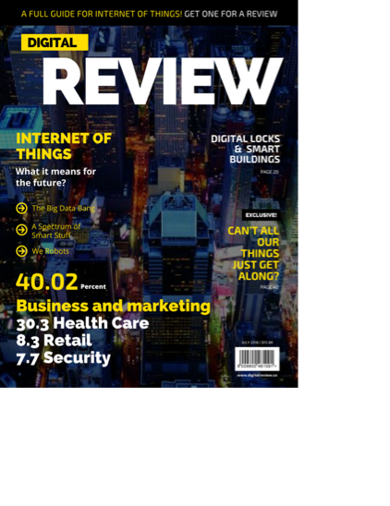
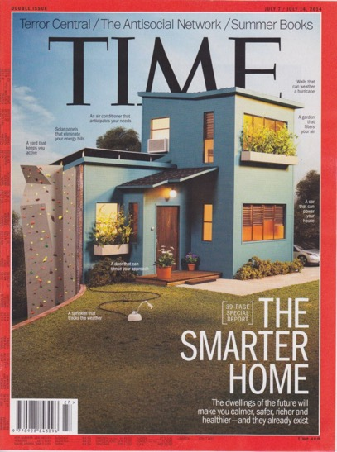

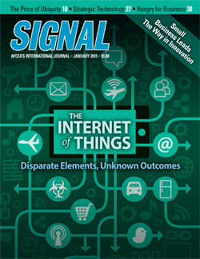

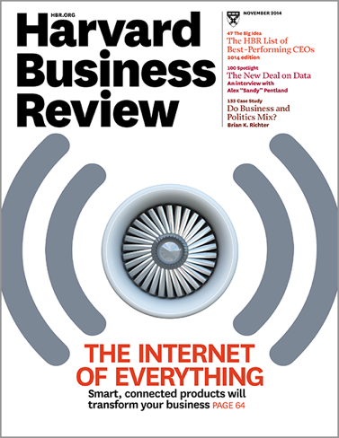

Slide 3
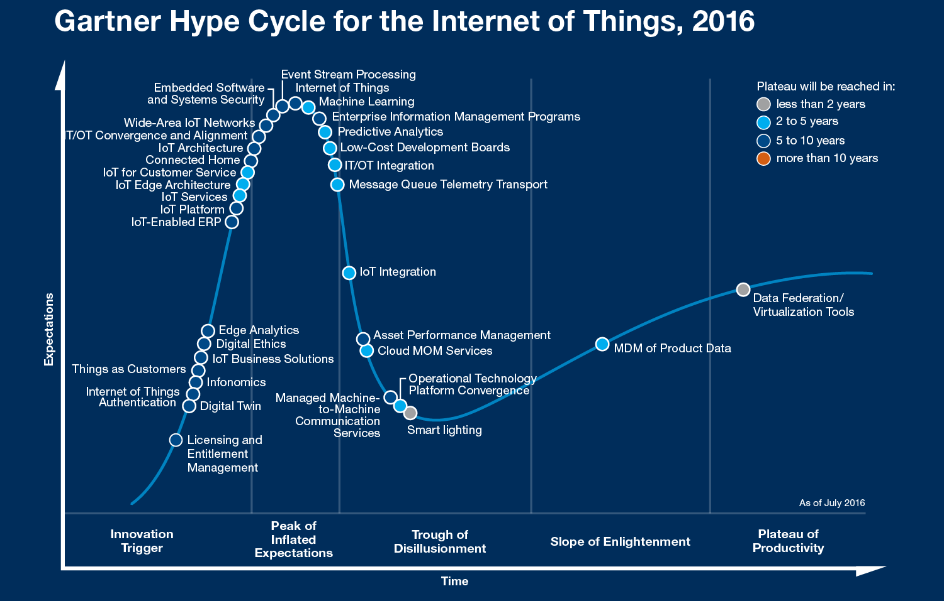

Slide 4
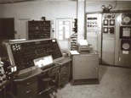
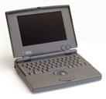
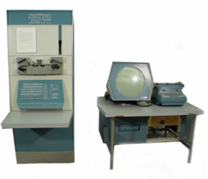
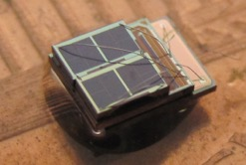

Bell’s Law of Computer Classes: A new computer class emerges roughly every decade
“Roughly every decade a new, lower priced computer class forms based on a new programming platform, network, and interface resulting in new usage and the establishment of a new industry.”
Mainframe
1 per Enterprise
[Bell et al. Computer, 1972, ACM, 2008]
Workstation
log (people per computer)
1 per Engineer
Smart Sensors
Laptop
1 per Professional
Mini Computer
1 per Company
Personal Computer
1 per Family
1 per person
100 – 1000’s per person
Smartphone

Slide 5
What makes this an exciting research area?
The applications.

Slide 6
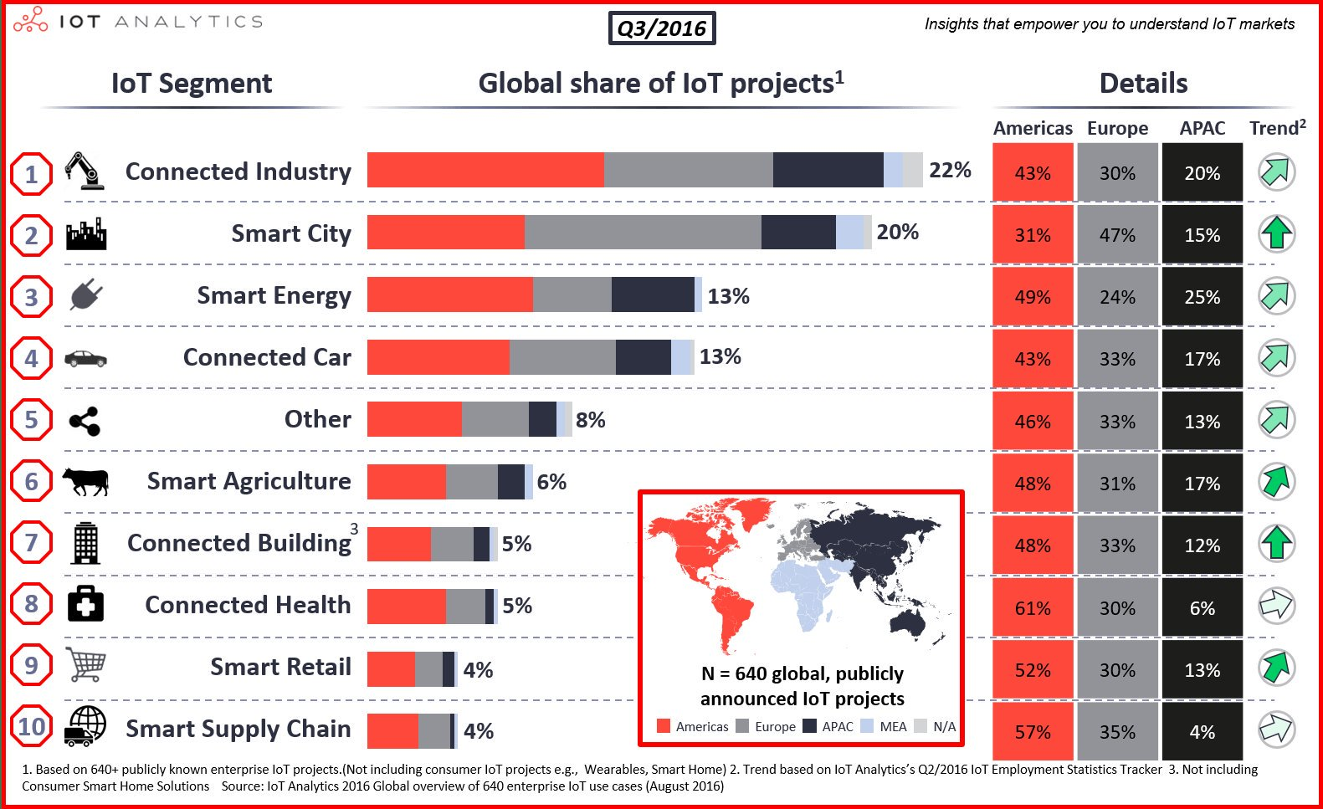

Slide 7
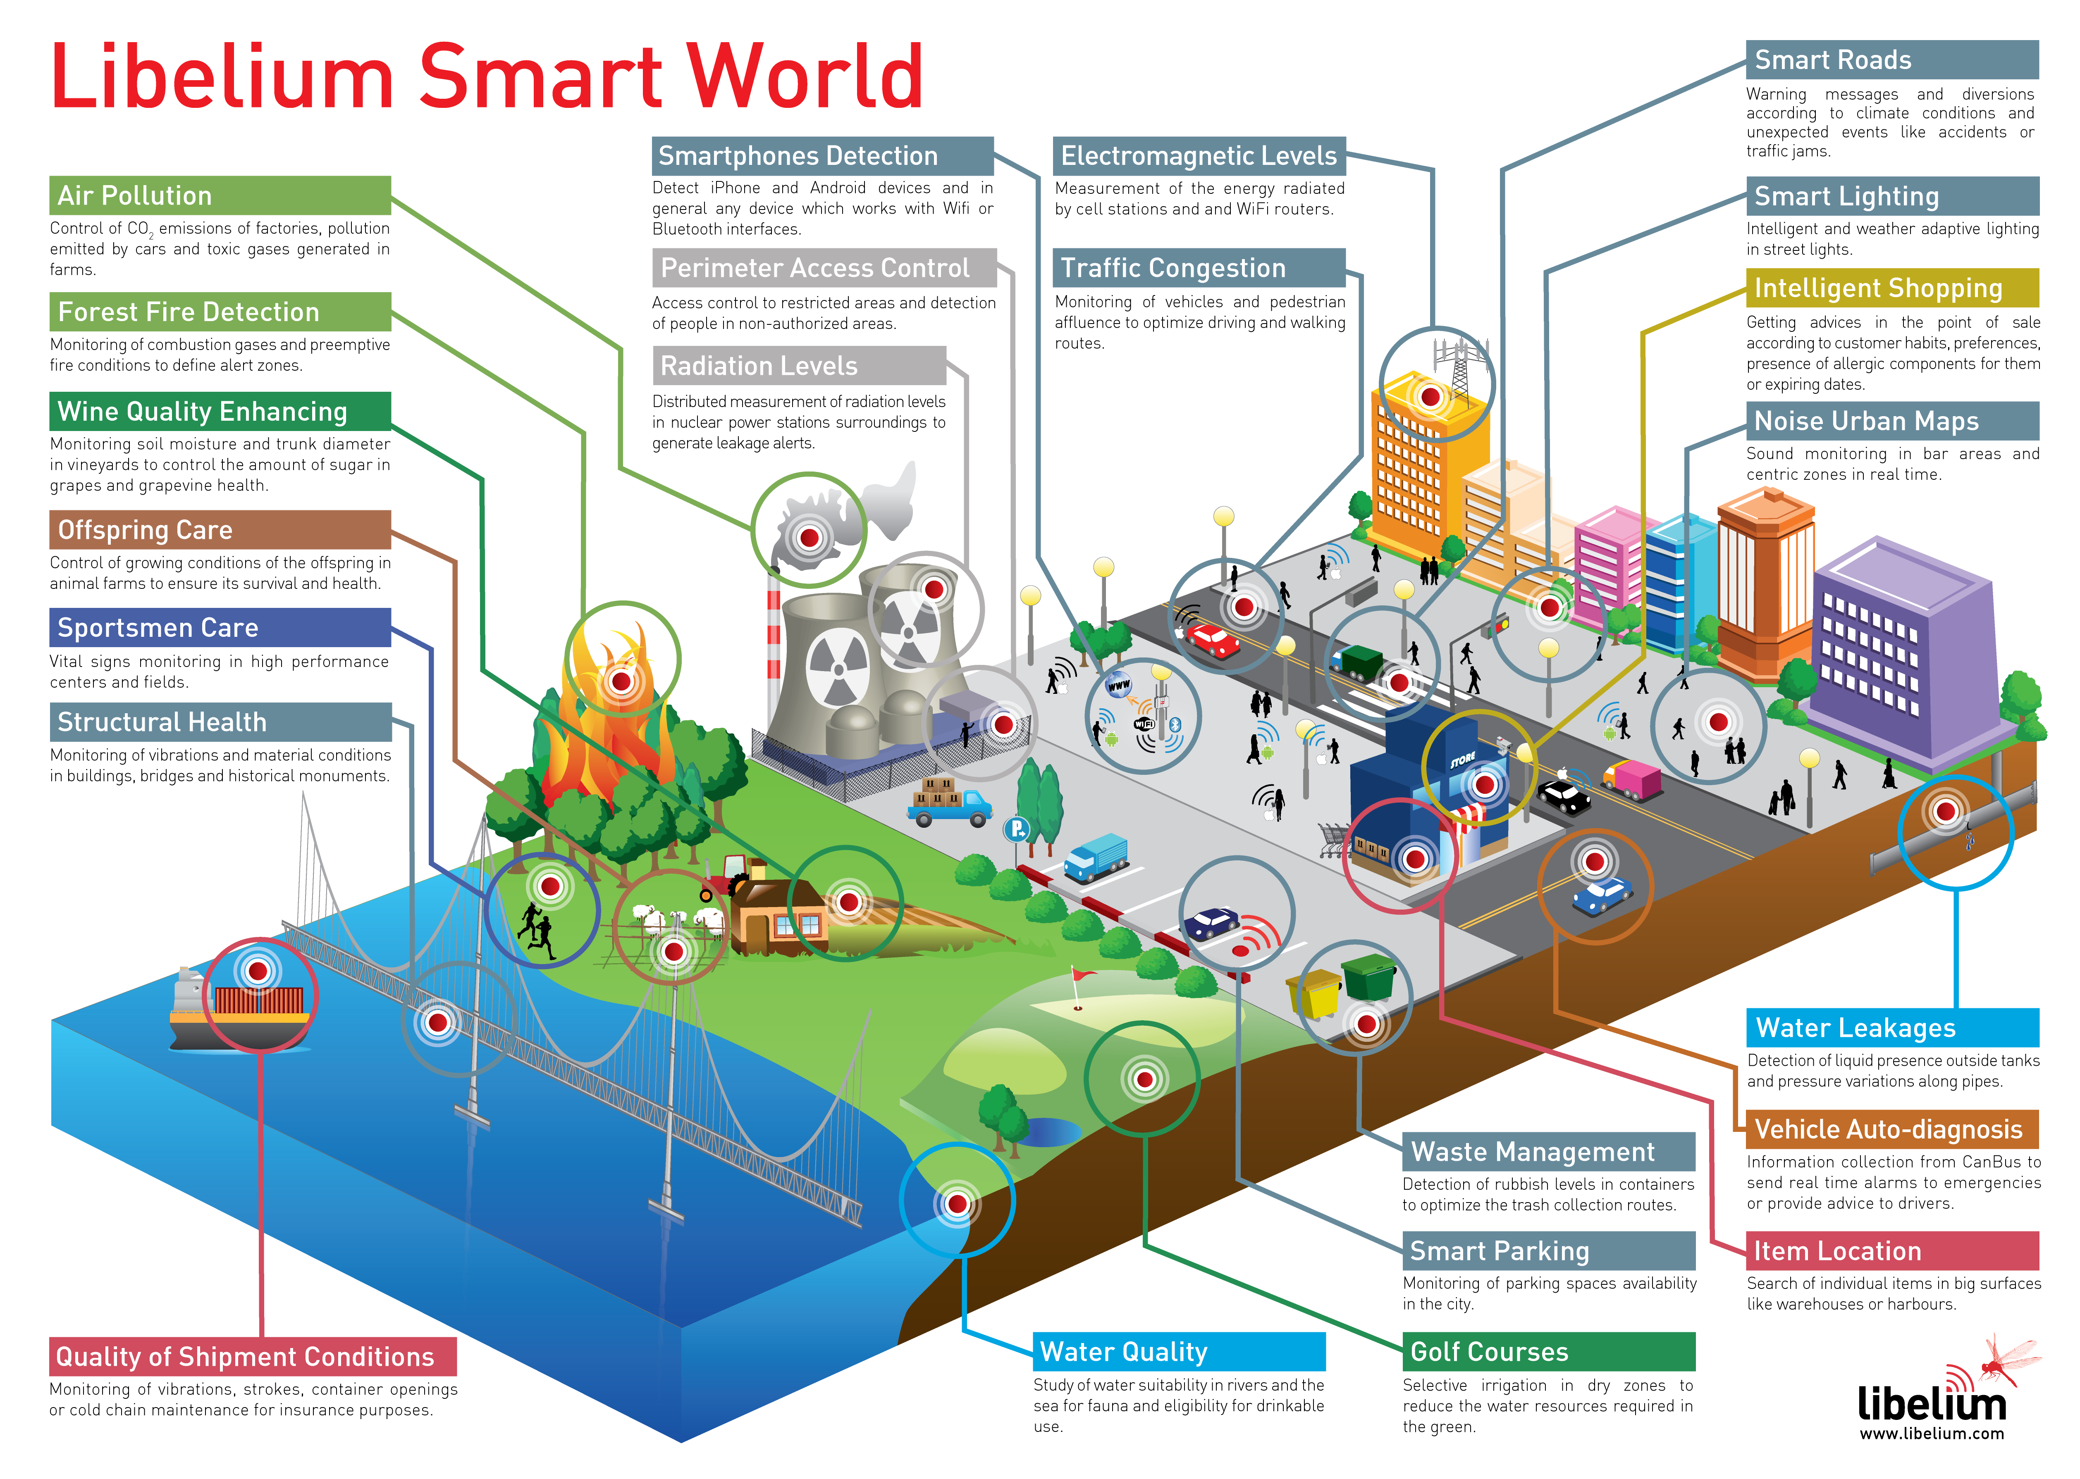
Notes:
IoT company

Slide 8
What makes this an exciting research area?
The applications.
The scale.

Slide 9
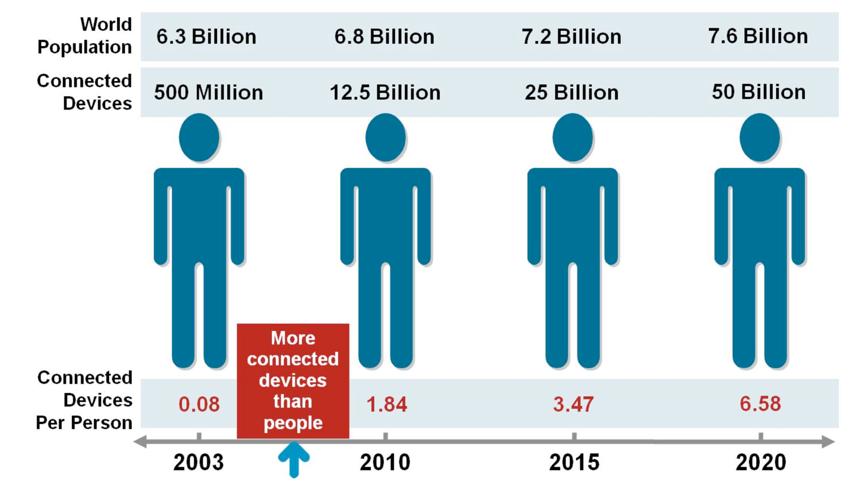
Cisco

Slide 10
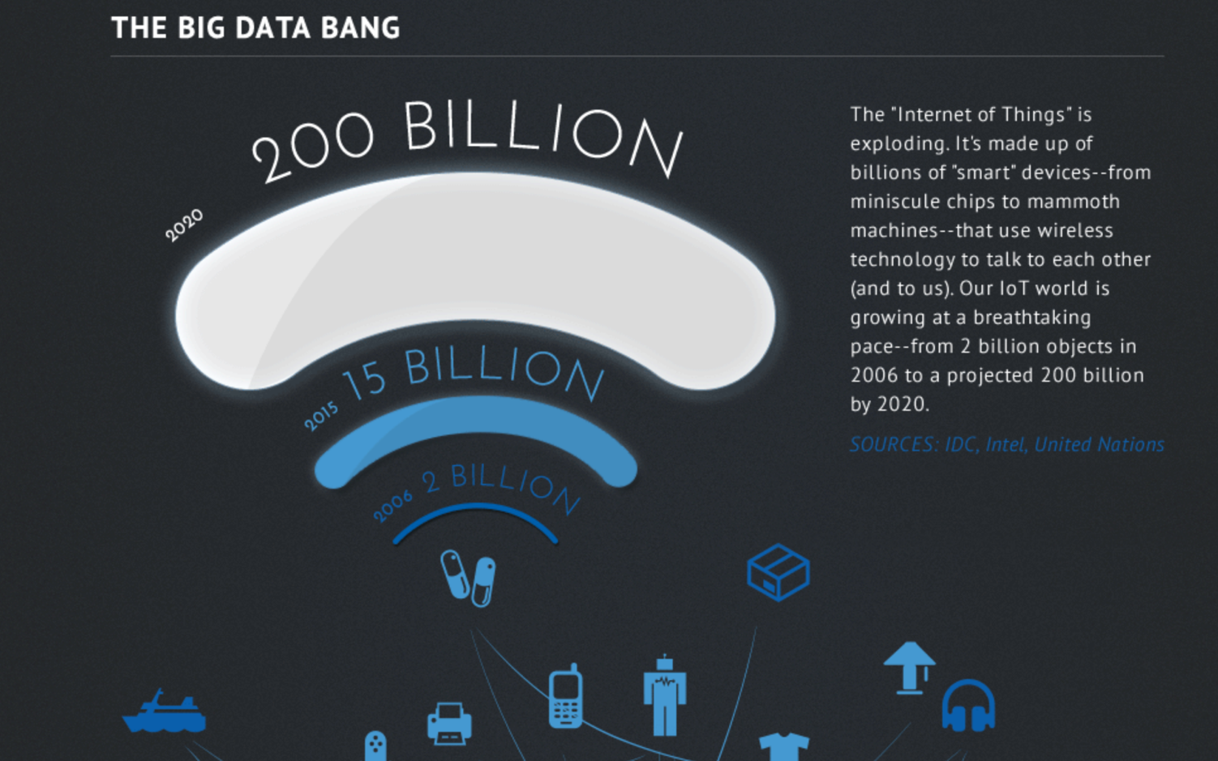
Intel

Slide 11
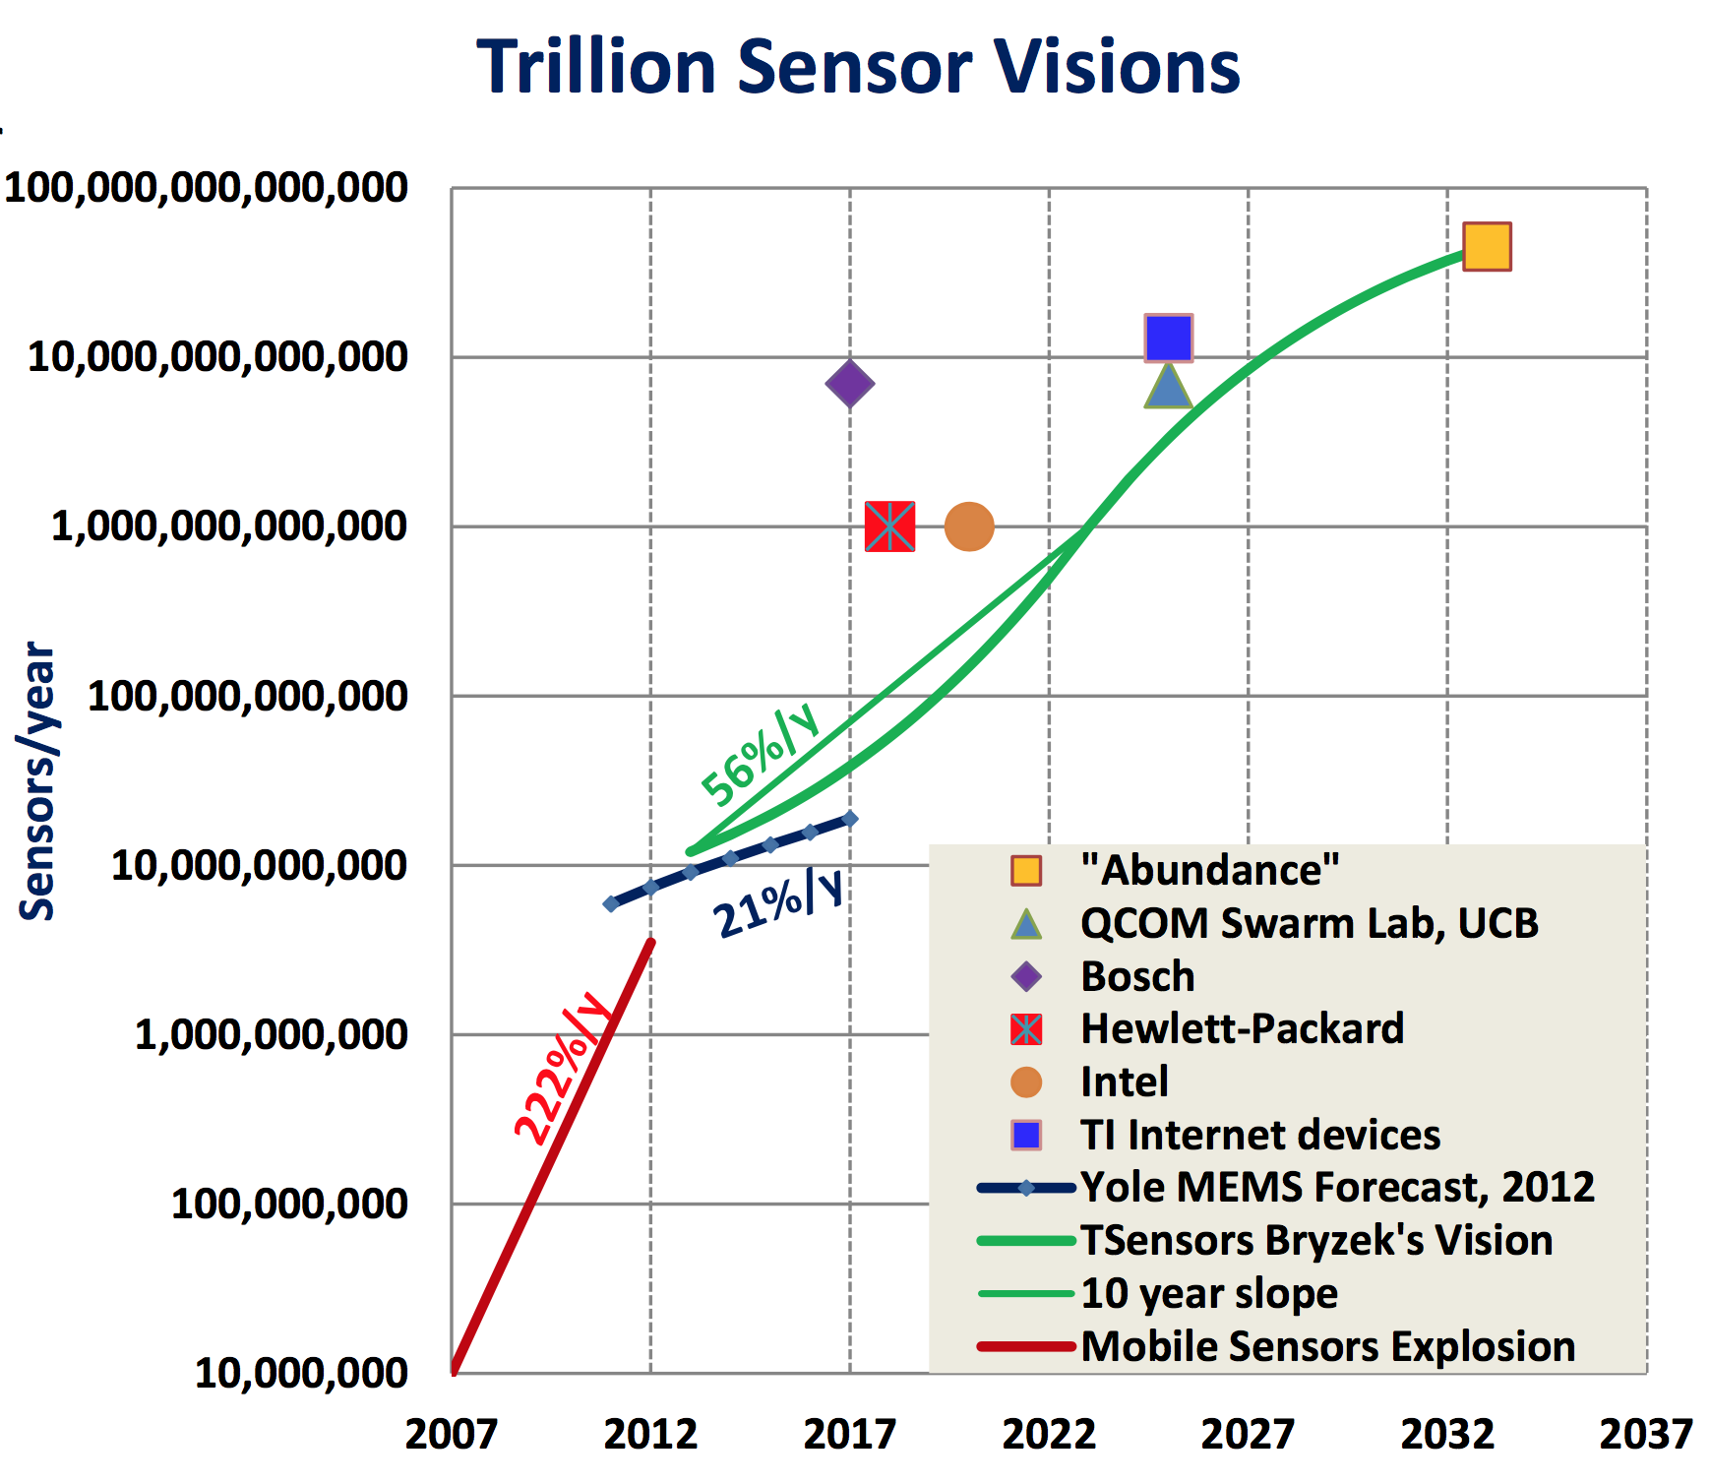
TSensors Summit

Slide 12
What makes this an exciting research area?
The applications.
The scale.
It cuts across the computing stack.

Slide 13
Layers of the IoT Stack
Data Analysis
Machine learning, deep learning, trend analysis
Cloud
Data Storage
Cloud, compression, security
Ensemble Programming
IFTTT, data flows
Gateway
User Interface
Applications
Connectivity
BLE, 802.15.4, Wi-Fi, 4G, networking, routing
Operating Systems
Device programming, security, updates
Embedded
Hardware Platforms
Environmental sensors, wearables, door locks, energy meters, etc.
Hardware Primitives
Microcontrollers, memory, radios, power supplies, energy storage, TPM

Slide 14
This Course
Will focus on the “embedded” and “gateway” tiers.
Will teach you about current research across various layers of this stack.
Will help you critically analyze research papers.
Will help you identify and understand the tradeoffs inherent to systems work.

Slide 15
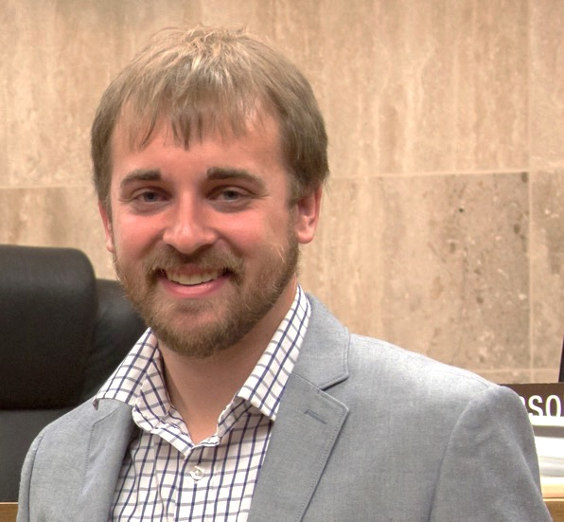
A little about me
Brad Campbell
Assistant professor
Joint appointment: 75% CS, 25% ECE
bradjc@virginia.edu
Ph.D. from the University of Michigan
Advisor: Prabal Dutta (now at Berkeley)
Research interests
Energy-harvesting systems
Embedded operating systems
New sensing systems
IoT systems programming

Slide 16
Overview
Intro
Course Overview
Requirements
Wrap-up

Slide 17
Main topics
Applications
Hardware platforms, energy, and sensors
Networking and communication
Operating systems and security

Slide 18
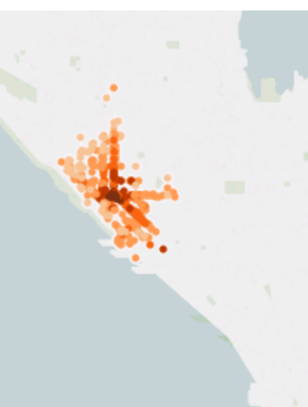
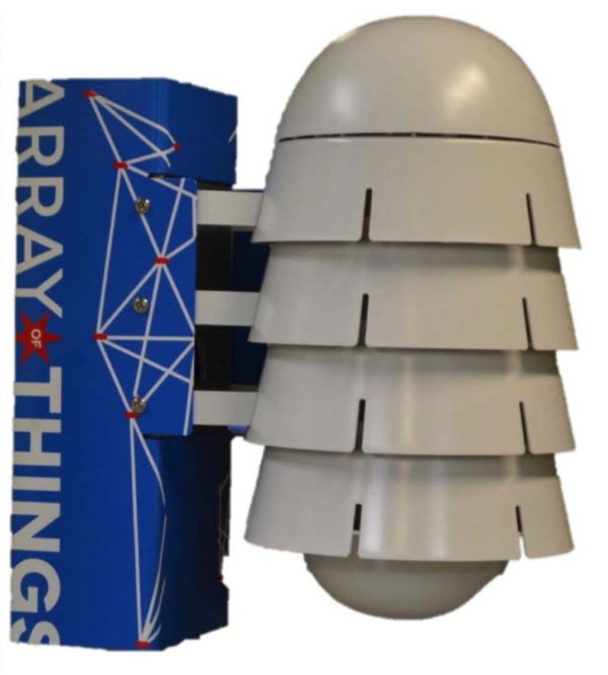
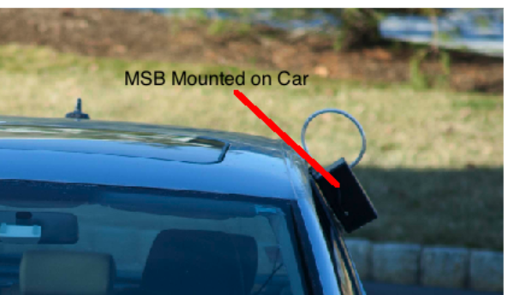
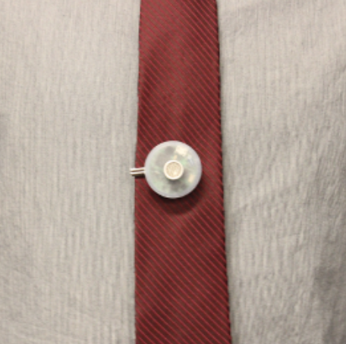
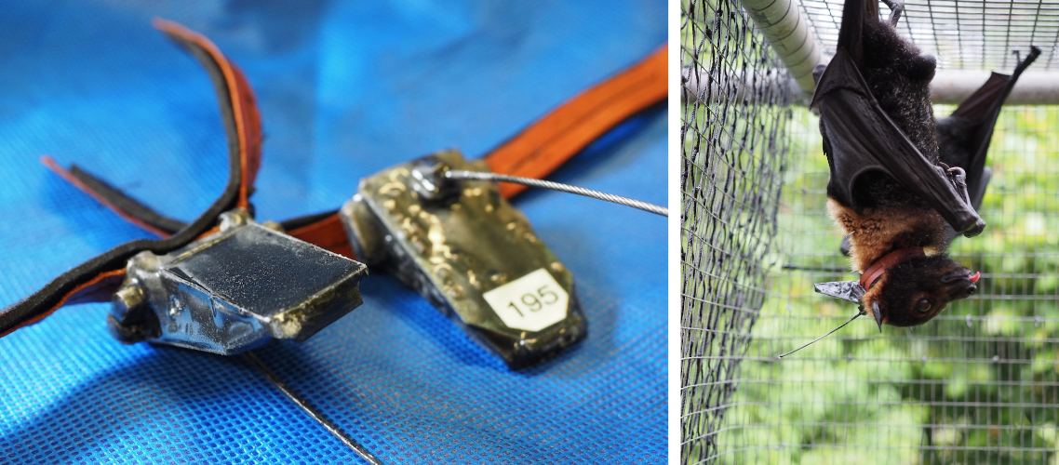
Applications
“Applications are of course the whole point” – Mark Weiser [paraphrased]
Many areas
Outdoor and environment monitoring
Buildings and energy
Safety and security
Industrial and infrastructure
Urban areas
Person health
Not just application overviews, but research systems that address specific aspects of the larger problem.

Slide 19
Application driven research
Motivated by actual problems in key domains.
Why?
Monetary: Government (and hence tax payers) invest not just for learning but also for societal benefit.
Practical: The real-world is a great testbed. Provides obvious evaluation metrics.
Impact: Real problems have more interested parties.
However, must balance with making an CS/EE contribution.
Culture here at UVa to facilitate cross-cutting application-driven research.

Slide 20
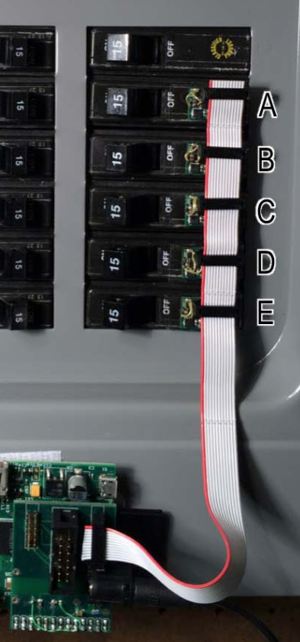
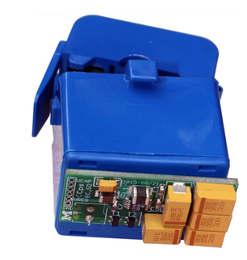
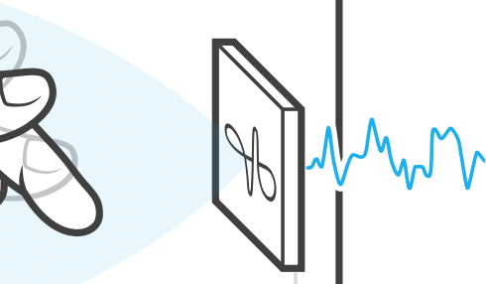
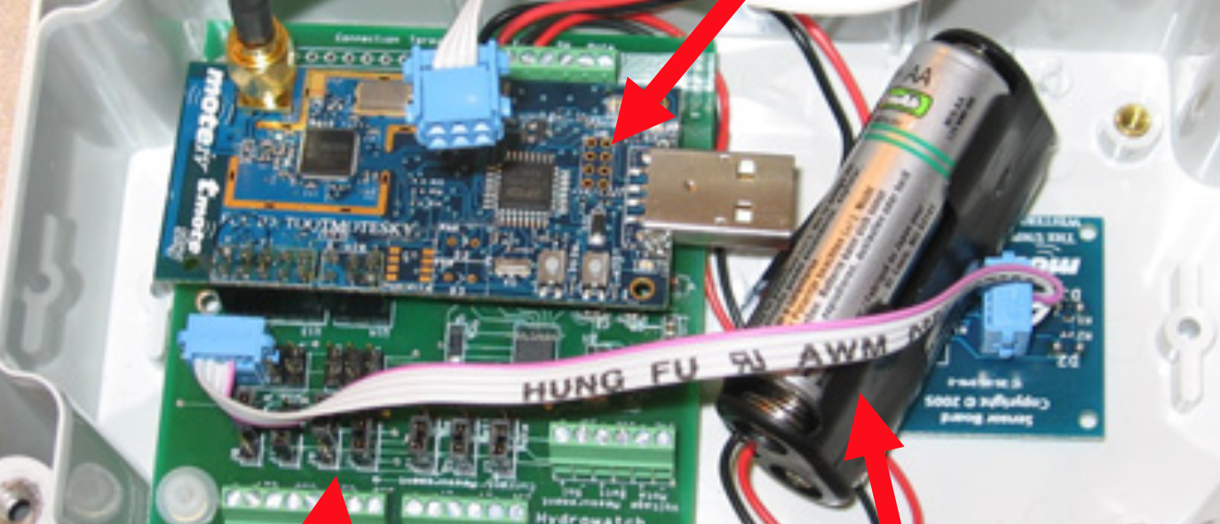
Hardware platforms, energy, and sensing
How to make devices meet their application goals while being unobtrusive, easy to install, and easy to maintain?
Hardware platforms
Reusable
Flexible
Research enabling research
Automatically generated?
Energy
Lower power means longer lifetime. Less maintenance.
Energy-harvesting
Sensing
A small taste of some recent sensors and sensing techniques.

Slide 21
Networking and Communication
Internet of Things
Quick survey of how these devices communicate.
Mesh networks (core of wireless sensor networks).
Single-hop networks (long and short range).
Role of the gateway tier.
New communication strategies.
Wi-Fi
1 W
802.15.4
LoRa
Power (log scale)
1 mW
BLE
Backscatter
1 uW
Harder to use
Difficulty of use

Slide 22
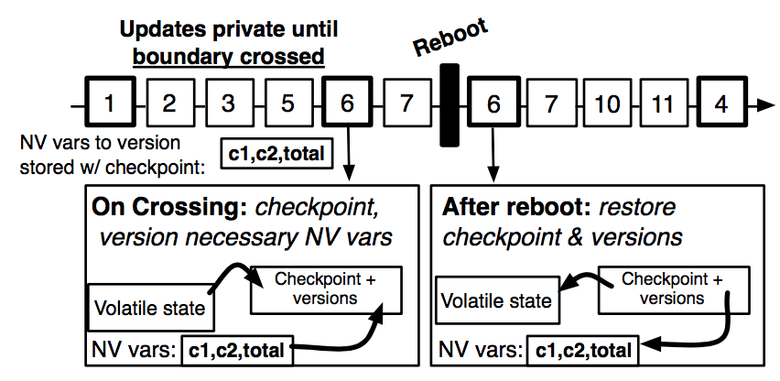
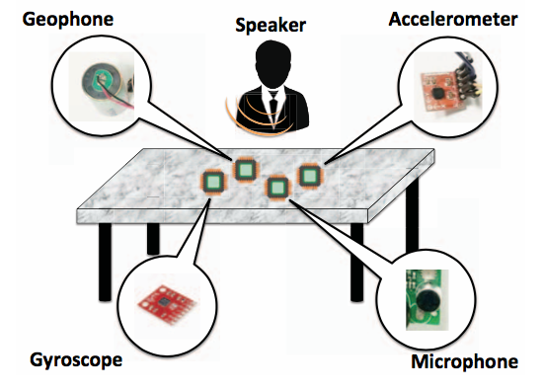
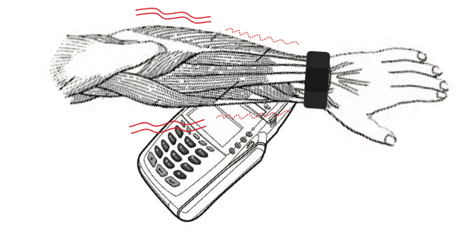
Operating Systems and Security
Programming constrained hardware effectively.
Multiprogramming embedded devices.
Compensating for energy-harvesting and intermittency.
Internet of Things
Need to leverage the scale of computing.
Spoiler: we aren’t very good at this yet.
Security aspects
Authorization
Misusing sensors

Slide 23
Overview
Intro
Course Overview
Requirements
Wrap-up

Slide 24
This is a research seminar
Goals: for you to be able to
Identify the scientific method in research papers
Analyze and critique existing research
Present and communicate clearly existing research
Apply those techniques to your own work

Slide 25
Scientific Method
Observation/topic/idea
Related work
Hypothesis
Experiments
Analysis
Conclusion
Independent and dependent variables.

Slide 26
Paper reviews
~2 reviews due before each class
Not long, but answer the following questions:
What is the problem this paper addresses, and why is it important?
What is the hypothesis of this paper?
What are two key assumptions that this paper makes?
What are the two main strengths of this paper?
What are the two main weaknesses of this paper?
Which figure or experiment was most compelling in support of the hypothesis, and why?
Sometimes the authors make these easy, other times you have to infer.
Being able to do this in your own work will make you a stronger researcher, communicator, and engineer.

Slide 27
Paper reviews cont.
Also fill in a quick survey about each paper:
Presentation (1-5):
Interest (1-5):
Impact (1-5):
Overall (1-5):
Confidence (1-5):
We’ll see how each paper ranks at the end of the semester.

Slide 28
In-class discussion lead
Each student must pick one class to be discussion lead.
Leads must
Introduce the papers.
Discuss the paper review questions.
Facilitate a discussion about the approach, merit, and impact of the papers.
I’ll do the first couple to give one approach to being discussion lead.

Slide 29
Semester project
Goal: Learn how to apply the scientific method to a research problem.
Not: Actually building a system.
Groups of 1-2.
Three phases:
Two page paper of your idea, hypothesis, why this is a worthwhile problem and that if it was solved it would matter, some related work, an overview of the approach, and some conclusions.
Four page paper with the above (expanded on) and a set of experiments to test and prove the hypothesis. Does not need to be the same idea.
Five to size page paper with the above, some preliminary results, and some expected results. In ACM conference format.

Slide 30
Semester project peer review
Two classes will be dedicated to reviewing each others’ papers.
Apply same mindset as with the assigned papers.

Slide 31
Grading
Breakdown
34%: Final project report presentation.
33%: In-class participation and discussion lead.
33%: Reviews and peer edit of project reports.

Slide 32
Office hours
Tuesdays 2 pm – 3:30 pm
512 Rice

Slide 33
Two weekends ago…

Slide 34
Next week Monday
No reviews, but read the two papers that set an overview for the area.
Sign-ups for discussion leads.

